Slide 1
Hybrid Quantum-Classical Graph Neural Networks for Track Reconstruction
Cenk Tüysüz¹, Carla Rieger²
¹Middle East Technical University, Ankara, Turkey
²ETH Zürich, Zürich, Switzerland
Quantum Technology Initiative meeting, 26.04.2021

Slide 2
Outline
Particle track reconstruction problem
Quantum Computing and Machine Learning
Hybrid Embeddings for Particle Tracking
Hybrid GNN approach
Comments on future improvements

Slide 3
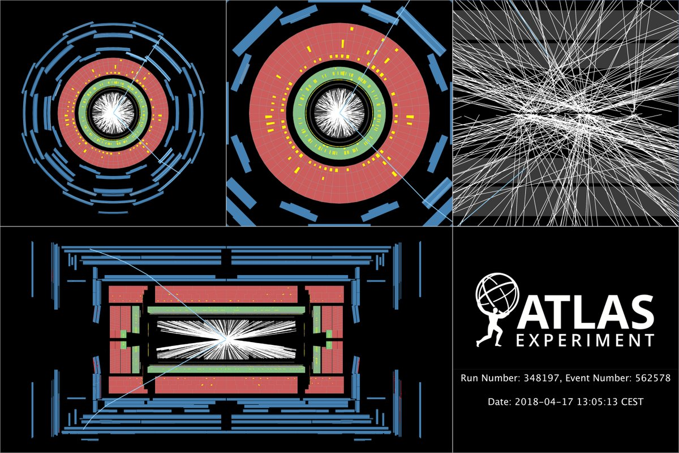
Large Hadron Collider (LHC)
and particle track reconstruction
An event view from ATLAS Experiment
https://atlas.cern/updates/atlas-news/counting-collisions
https://cds.cern.ch/record/2315786

Slide 4
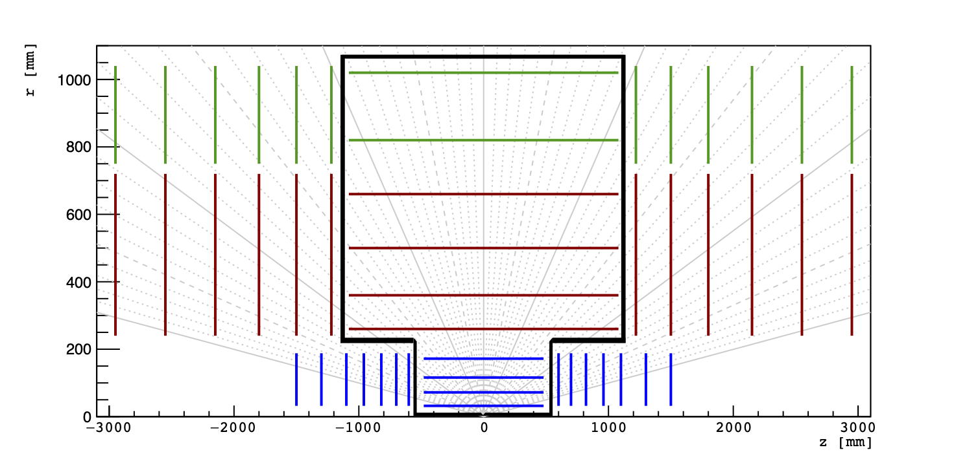
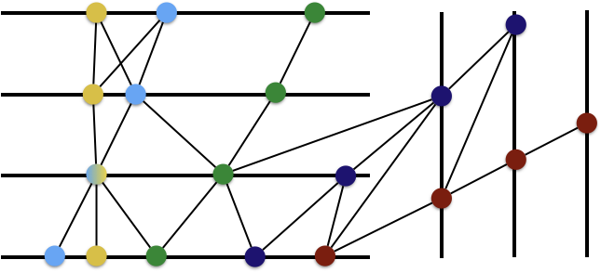
TrackML Dataset
https://www.kaggle.com/c/trackml-particle-identification/overview
endcaps produce a lot of ambiguity and therefore many track candidates, we omit endcaps as we want to limit our model to simpler cases.
Contains: 10k collision events (200 soft QCD interactions)
(arXiv: 1904.06778)
Retrieved from: Farrell et al. 2018 (arXiv: 1810.06111)

Slide 5
Learning the embedding of the hit data set
The data processing pipeline
First Preprocessing Steps
of the data set
Embedding of pairs of hits (doublets): 𝚽(x_{i} , 𝜃) in 4D embedding space
Graph construction and classification with (quantum) GNN
hit j (x_{j})
Hinge Embeddig Loss:
true or false edge (indicated by label y_{i,j} )
hit i (x_{i})
A doublet in original space.
Similar to: Choma et al. 2020(arXiv: 2007.00149)

Slide 6
Hybrid Neural Network architecture
3D Input Data (hits)
4D Output Data in Embedded Space
Classical MLP
(hidden layers: n_layers x 512)
Quantum Circuit
Fully Connected Layer
General model of the hybrid architecture
MLP adapted from: Choma et al. 2020(arXiv: 2007.00149)

Slide 7
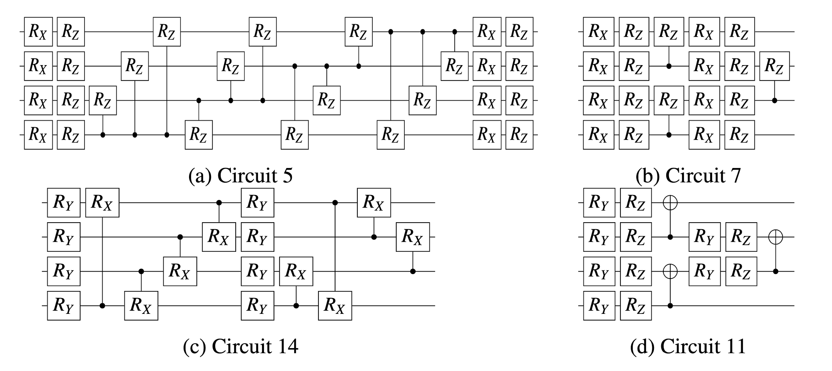
Quantum Circuit Approach
those quantum circuits were chosen due to their different values regarding entanglement and expressibility
they act as an encoding function, each of the rotational gates exhibits a free parameter
Circuits adapted from and values calculated as in: Sim et al. 2019 (arXiv:1905.10876)

Slide 8
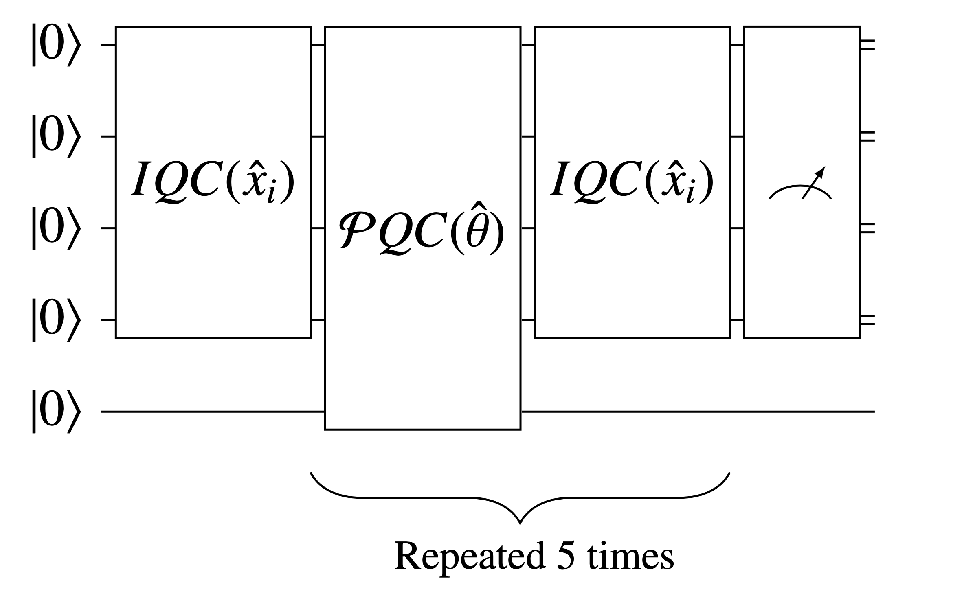
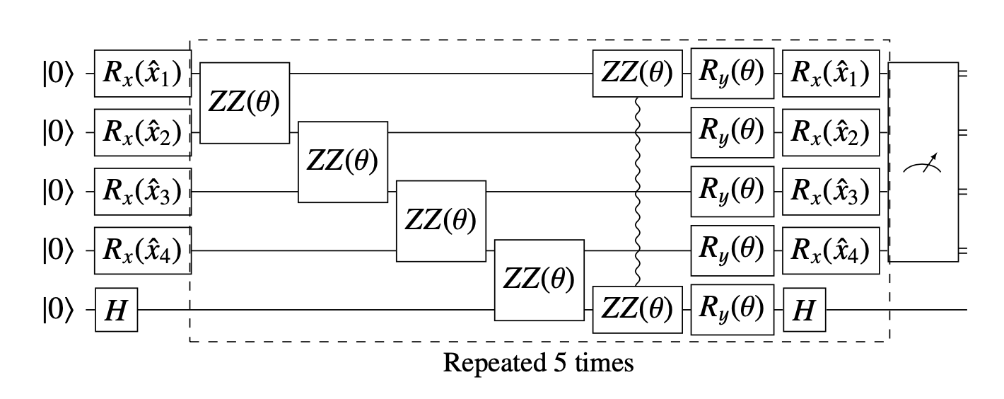
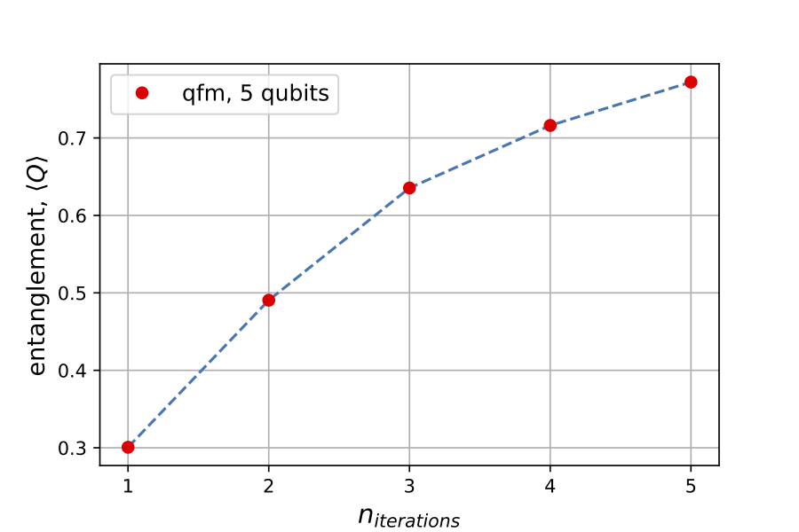
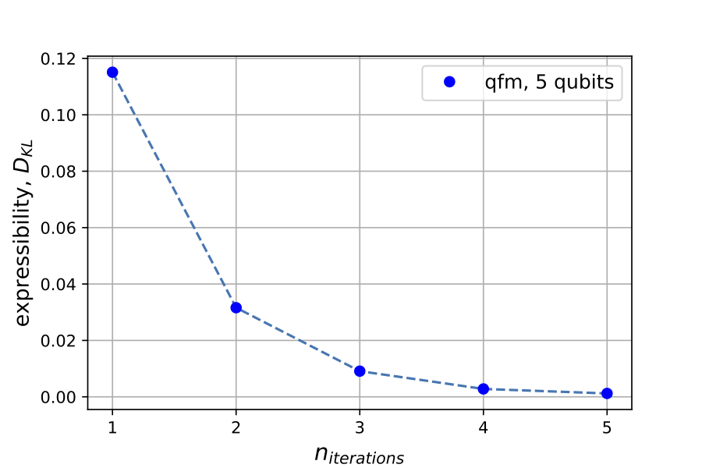
Quantum Feature Map Approach
(QFM)
QFM iteratively encodes the input x_{i}
additionally, there are optimizable parameters 𝜃 included within the quantum circuit
repeating blocks of the circuit as indicated on the left increases the entanglement and decreases the expressibility value, which is preferable
Adapted from: Lloyd et al. 2020 (arXiv:2001.03622)

Slide 9
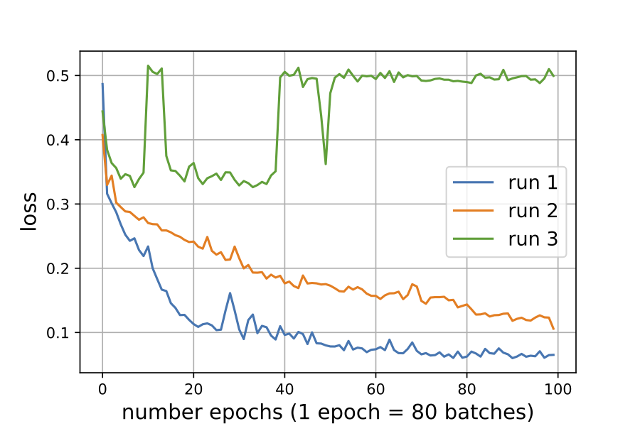
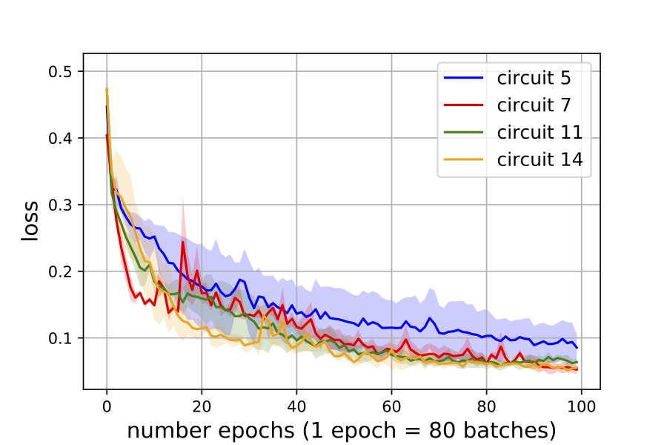
Training results
Quantum Circuit Approach
training time increases with increasing number of gates in the quantum circuit
observation of plateaus in training/validation loss for circuit 5, which includes the highest number of QC parameters in this test
*
Training data set: 8k hits, validation data set: 2k hits, using ADAMAX optimizer, n_layers = 10, hinge embedding loss, lr = 1e-2.
* mean and indicated std of 3 independent runs, plot without circuit 5 run 3 for better visualization
Ent./Expr. values calculated as in: Sim et al. 2019 (arXiv:1905.10876)

Slide 10
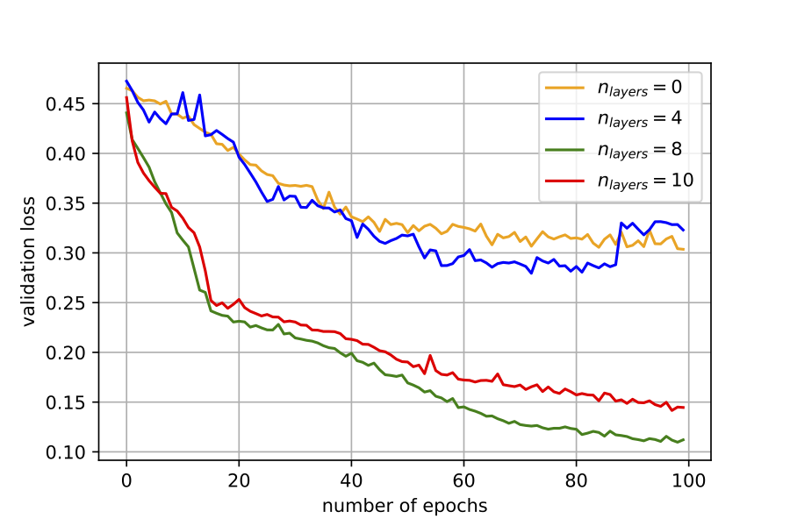
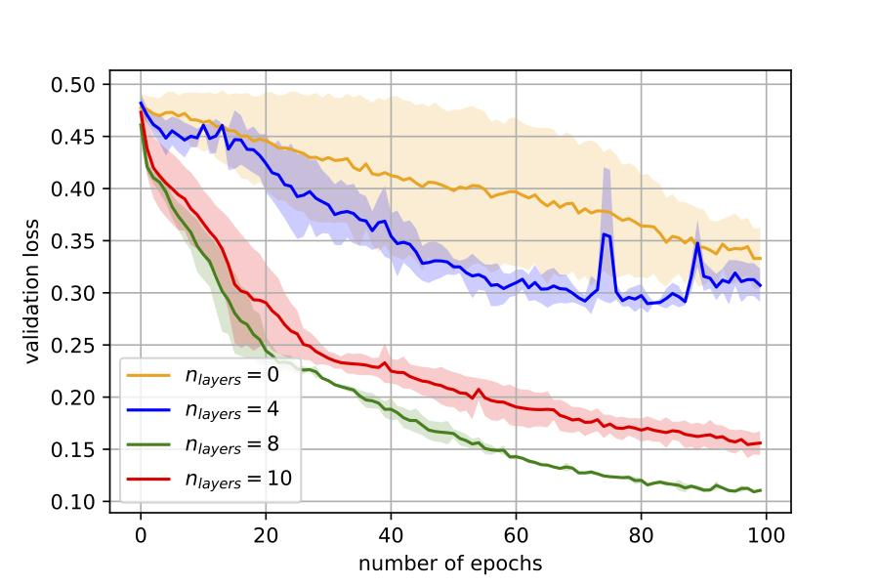
Training results
QFM Approach
learning rate has to be lowered using this architecture by factor 0.1
similar performance of 0 and 4 layer version, as well as for 8 and 10 classical layers
validation loss converges to high validation loss for low number of layers
std much higher when training with less classical layers
possibility for better convergence when training for more than 100 epochs (especially for 8 and 10 layers)
*
Training data set: 8k hits, validation data set: 2k hits, using ADAMAX optimizer, hinge embedding loss, lr = 1e-3.
* mean and indicated std of 2 independent runs
Ent./Expr. values calculated as in: Sim et al. 2019 (arXiv:1905.10876)

Slide 11
Quantum Graph Neural Network
Node information
(3D cylindrical coordinates)
(Graph connectivity matrix)
(Graph connectivity matrix)

Slide 12
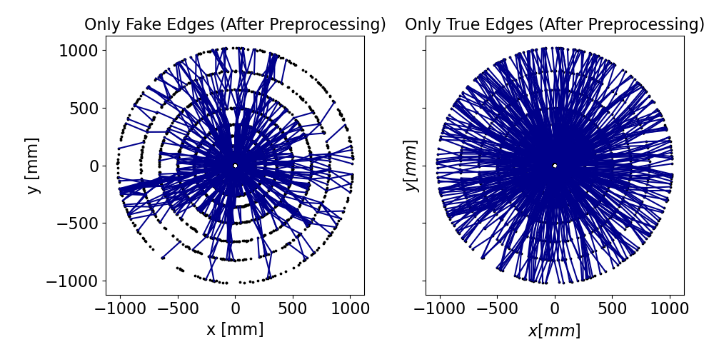
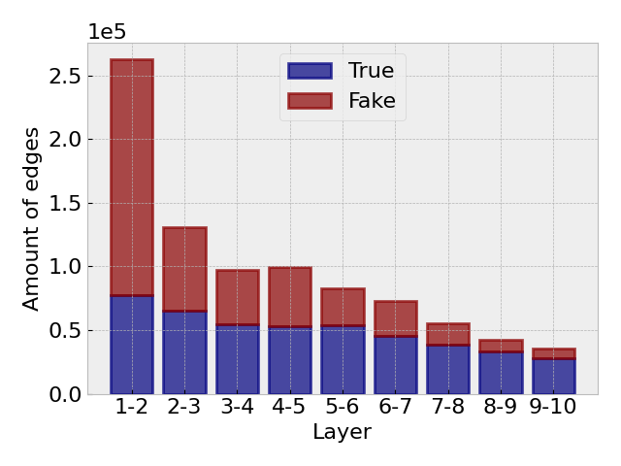
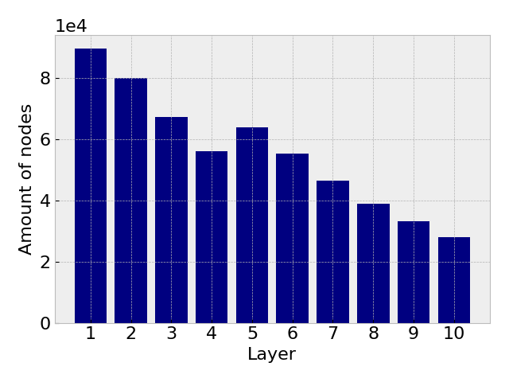
Preprocessing
After preprocessing (100 events):
Total edges: 880k (true: 450k, fake: 430k)
Total nodes: 560k
edges per graph: 8783.7 +/- 1877.3
nodes per graph: 5583.1 +/- 804.4
Distribution of 100 graphs

Slide 13
Edge Network
Edge Network:
Input: Node information of each edge
Learn edge features
v_{i} = [r_{i}, ϕ_{i}, z_{i}, h_{i}¹, … , h_{i}^{N} ]
v_{j} = [r_{j}, ϕ_{j}, z_{j}, h_{j}¹, … , h_{j}^{N} ]
N = hidden dimension size
Node j (v_{j})
[v_{i} , v_{j} ]
Edge Network
e_{ij}
= 0 if edge is fake
= 1 if edge is true
Edge
Features
Node i (v_{i})

Slide 14
Node Network
Node Network:
Input: Triplet node information
Learns hidden node features
combine nodes using the output of the edge network
Neighbour Nodes
(v_{i} , v_{j} , v_{k} )
v_{input} = v_{j} . e_{jt} + v_{k} . e_{kt}
i
i
Target Node (v_{t} )
v_{output} = v_{i} . e_{it}
[v_{input} , v_{output} , v_{target} ]
Node Network
h_{target} (update hidden node features)

Slide 15
Hybrid Neural Network
Single Fully Connected Layer
Variational Quantum Circuit
Single Fully Connected Layer
IQC (Information Encoding Quantum Circuit): Encodes the Classical Information to Quantum States
PQC (Parametrized Quantum Circuit): Contains trainable parameters that does operations to the Quantum States on the Hilbert Space

Slide 16
Parametrized Quantum Circuits
Circuits are taken from (Sim et al. 2019, arXiv:1905.10876)
a layer
Circuit 10:
Circuit 19:
a layer
Layers are repeated blocks of Quantum Circuits. (They can have the same or different parameters)

Slide 17
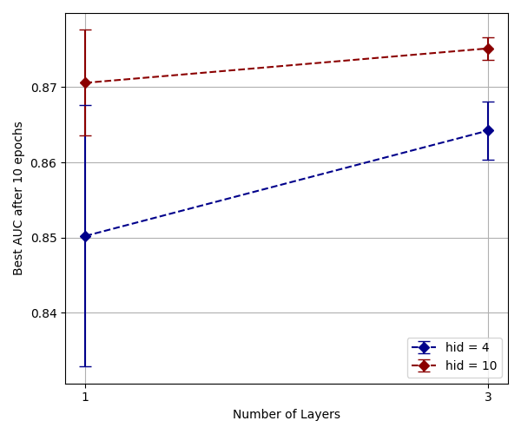
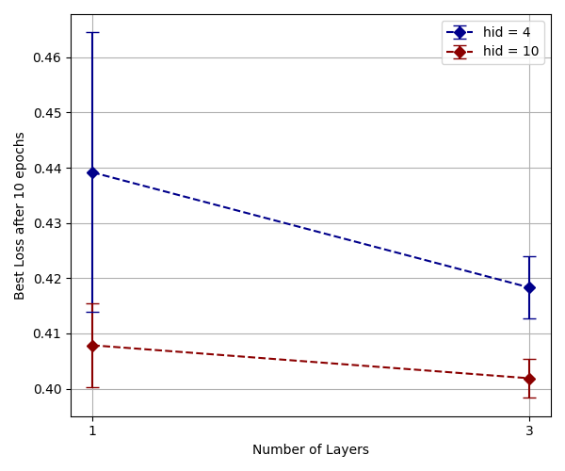
Training Results
AUC: Area Under ROC, a measure of accuracy for different thresholds.
AUC = 1.0 means perfect score.
Number of Layers (N_{iteration} = 3, qc = 19, N_{hid} = 4, N_{qubits} = 4)
N_{Layers} has a positive effect on the performance as expected!
Training set: 50 graphs, Test set: 50 graphs, using ADAM, binary cross entropy, lr = 0.01, analytic results.

Slide 18
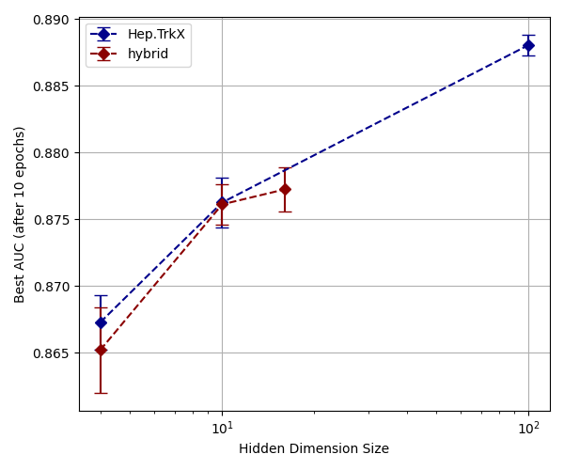
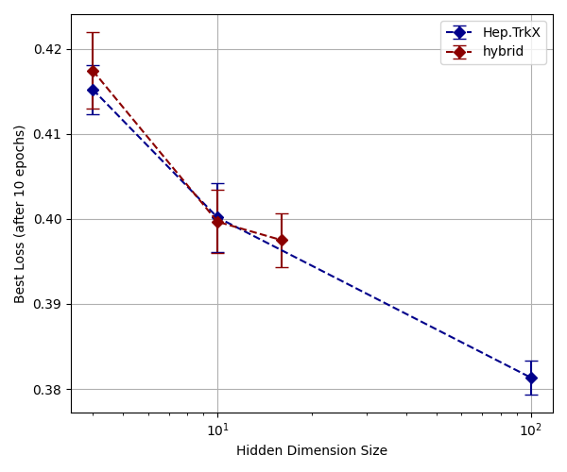
Training Results
AUC: Area Under ROC, a measure of accuracy for different thresholds.
AUC = 1.0 means perfect score.
Comparing Results with Hep.TrkX (N_{iteration} = 3, qc = 10 with 1 layer)
Farrell et al. 2018 (arXiv: 1810.06111)
Our approach shows similar characteristics.
But, it can achieve better AUC and loss with better circuits and more layers!
Training set: 50 graphs, Test set: 50 graphs, using ADAM, binary cross entropy, lr = 0.01, analytic results.

Slide 19
Conclusion
QGNN results are promising. They can achieve similar performance compared to a novel classical model. However, there are still challenges to use this algorithm on a Quantum Computer.
How to improve?
Use more layers.
Explore different circuits.
Explore different architectures.
Use more events.
Challenges
Simulation times are long. Quantum models are hard to simulate. (Training takes 1-2 days depending on model complexity)
Things to explore
Effects of hardware and shot noise.
Complete overview with more layers and iterations.

Slide 20
Contributors
C. Tüysüz¹, C. Rieger², K. Novotny³, B. Demirköz¹, D. Dobos^{3,4}, K. Potamianos^{3,5}, S. Vallecorsa⁶, J.R. Vlimant⁷, Richard Forster³
¹Middle East Technical University, Ankara, Turkey, ²ETH Zurich, Zurich, Switzerland,
³gluoNNet, Geneva, Switzerland,
⁴Lancaster University, Lancaster, UK,
⁵Oxford University, Oxford, UK,
⁶CERN, Geneva, Switzerland,
⁷California Institute of Technology, Pasadena, California, USA,

Slide 21
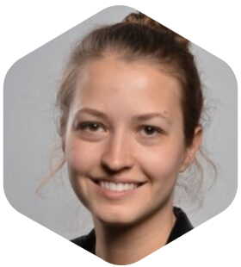
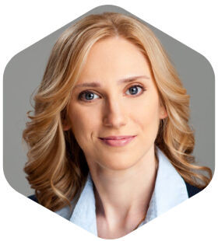
Contributors
C. Tüysüz^{1,2}, C. Rieger⁸, K. Novotny⁴, B. Demirköz¹, D. Dobos^{4,6},
K. Potamianos^{4,5}, S. Vallecorsa³, J.R. Vlimant⁷
¹Middle East Technical University, Ankara, Turkey, ²STB Research, Ankara, Turkey, ³CERN, Geneva, Switzerland, ⁴gluoNNet, Geneva, Switzerland, ⁵Oxford University, Oxford, UK, ⁶Lancaster University, Lancaster, UK, ⁷California Institute of Technology, Pasadena, California, USA, ⁸ETH Zurich, Zurich, Switzerland

Slide 22
Thank you.
Email: ctuysuz@cern.ch, carieger@ethz.ch
Results shown here will be published soon, with a complete overview.
You can refer to our recent conference paper for previous results: arXiv:2012.01379
The current code base will be public with the release of the paper.
You can refer to our old codebase: https://github.com/cnktysz/HepTrkX-quantum

Slide 23
Backup Slides

Slide 24
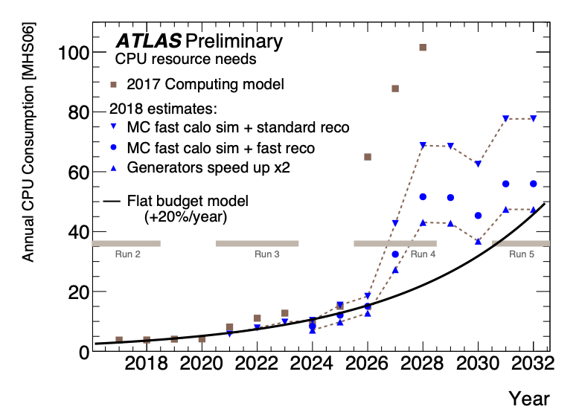
High Luminosity LHC
High Luminosity upgrade of LHC brings many computational challenges.
Number of tracks is expected to be increase by 12-15 times
 | Run 1 | Run 2 | Run 3
μ | 21 | 40 | 150-200?
Tracks | ~280 | ~600 | ~7-10k
μ: Average number of interactions per bunch crossing
H. Gray, Track reconstruction in the ATLAS experiment, 2016.
ATLAS computing model projections for Phase-2

Slide 25
Hep.TrkX GNN
Model Scores (with 0.5 threshold):
Purity: ﻿99.5%, Efficiency: 98.7%
Overall Accuracy: 99.5%
Segment Classification
arXiv: 1810.06111
The project is extended with the name Exa.TrkX to continue investigating use of GNNs in track reconstruction.
https://exatrkx.github.io
arXiv:2007.00149

Slide 26
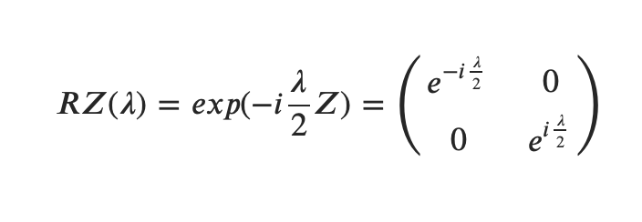
Q.C. for Machine Learning
Parameterized Gates
We can use parameterized gates to embed data in the Hilbert Space.
Adapted from: Sim et al. 2019 (arXiv:1905.10876)
Train
Classify
Then, we can use other parametrized gates that we can optimize to do tasks such as classification.
Adapted from: Lloyd et al. 2020 (arXiv:2001.03622)

Slide 27
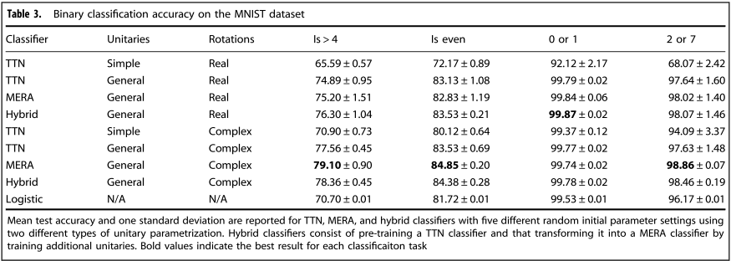
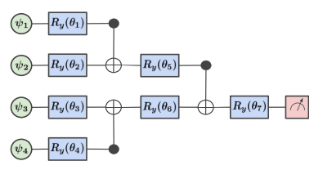
Quantum Classification
arXiv: 1804.03680

Slide 28
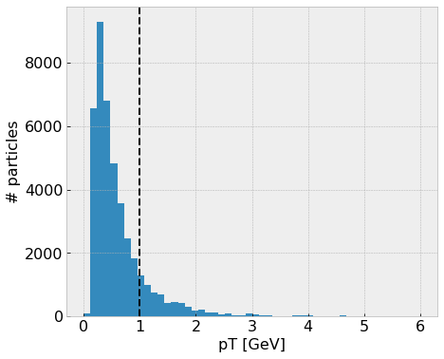
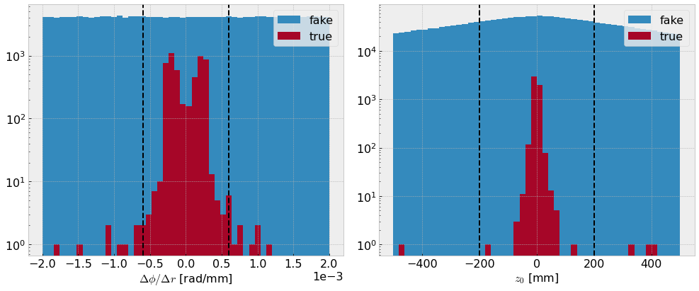
Preprocessing
pT distribution of an event
apply cuts to segments
~15% of hits survive
|Δr/Δ𝜙| | < 0.0006
|z₀| | < 200 mm
|𝜂| | < 5
Use hits of particles
with pT > 1 GeV
Use only the barrel region to avoid track ambiguity.
Only 100 events are used!
The preprocessing is used to reduce both the track ambiguity and the size of the dataset. Quantum Machine Learning simulations can not handle large datasets at the moment!

Slide 29
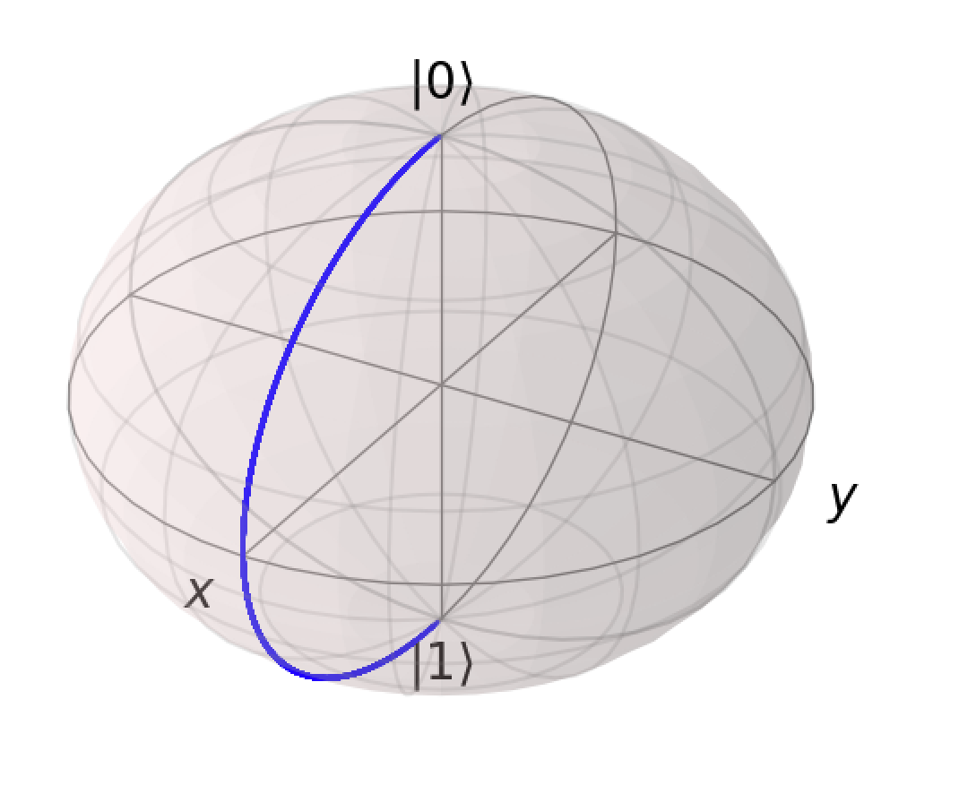
Information Encoding Quantum Circuit
We limit the use of full bloch sphere for two reasons:
Full circle prevents a 1-1 relation between data and measurements
Use of full sphere requires complex PQCs (on our radar for future improvements)
x_{i} ∈ [0, 𝜋]
Simple Angle Encoding Circuit:
Requires N_{qubits} = Size of the input
Single Qubit Bloch Sphere Representation

Slide 30
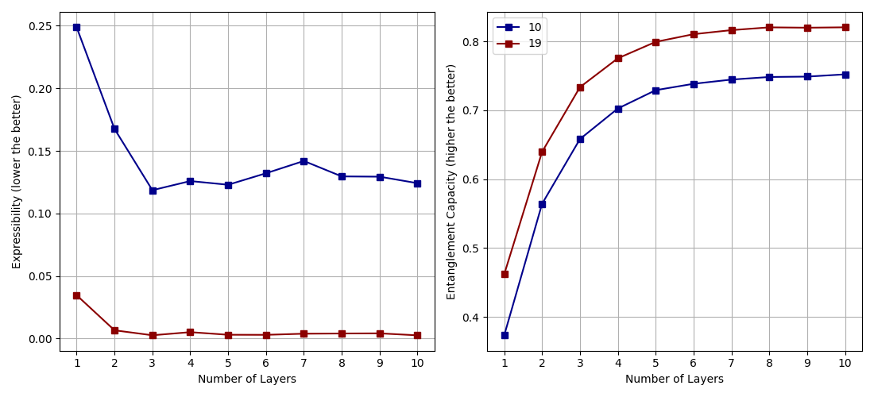
Parametrized Quantum Circuits
How do we choose a Quantum Circuit?
There are metrics in the literature to assess the capacity of Quantum Circuits.
However, they haven’t been shown to have correlation with their learning capacity (yet)!
(Sim et al. 2019 (arXiv:1905.10876))

Slide 31
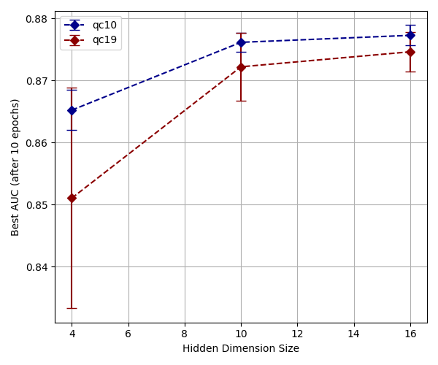
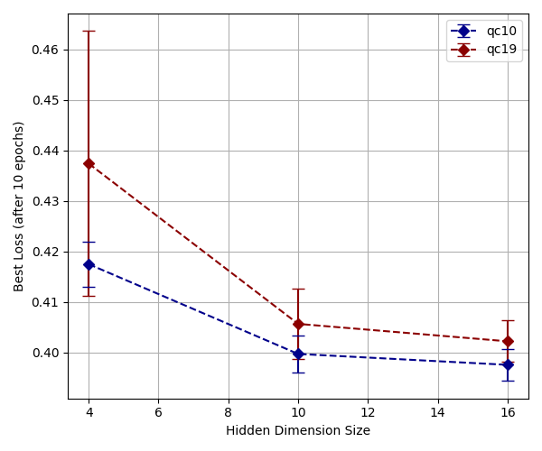
Training Results
AUC: Area Under ROC, a measure of accuracy for different thresholds.
AUC = 1.0 means perfect score.
Hidden Dimension Size (N_{qubits} = N_{hid} , N_{layers} = 1, N_{iteration} = 3)
Hidden Dimension size has a positive effect on the performance as expected.
Training set: 50 graphs, Test set: 50 graphs, using ADAM, binary cross entropy, lr = 0.01, analytic results.

Slide 32
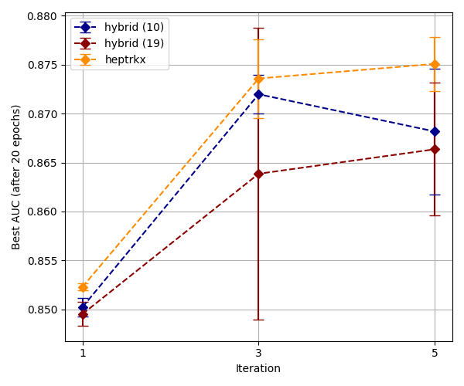
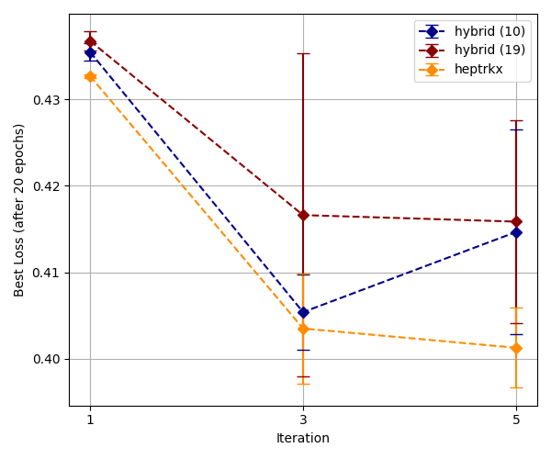
Training Results
AUC: Area Under ROC, a measure of accuracy for different thresholds.
AUC = 1.0 means perfect score.
very small
Number of Iterations (N_{qubits} = 4, N_{hid} = 4, N_{layers} = 1)
N_{iterations} has a positive effect on the performance as expected!
(Exa.TrkX team reported 8 as the optimum amount.)
https://exatrkx.github.io
Training set: 50 graphs, Test set: 50 graphs, using ADAM, binary cross entropy, lr = 0.01, analytic results.

